Slide 1


Dayspring Programs
Johns Hopkins University School of Nursing, Spring 2019

Slide 2
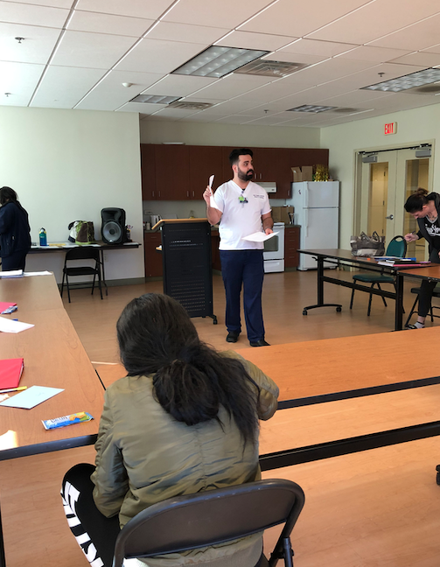
9 Total Health Classes
Heart Health
Environmental Hazards
Asthma Management
Smoking Cessation
Exercise & Hydration
Stress Management Techniques
Healthy Boundaries (“I Statements”)
Child Developmental Stages
Goal: To promote healthy behaviors and improve health management

Slide 3
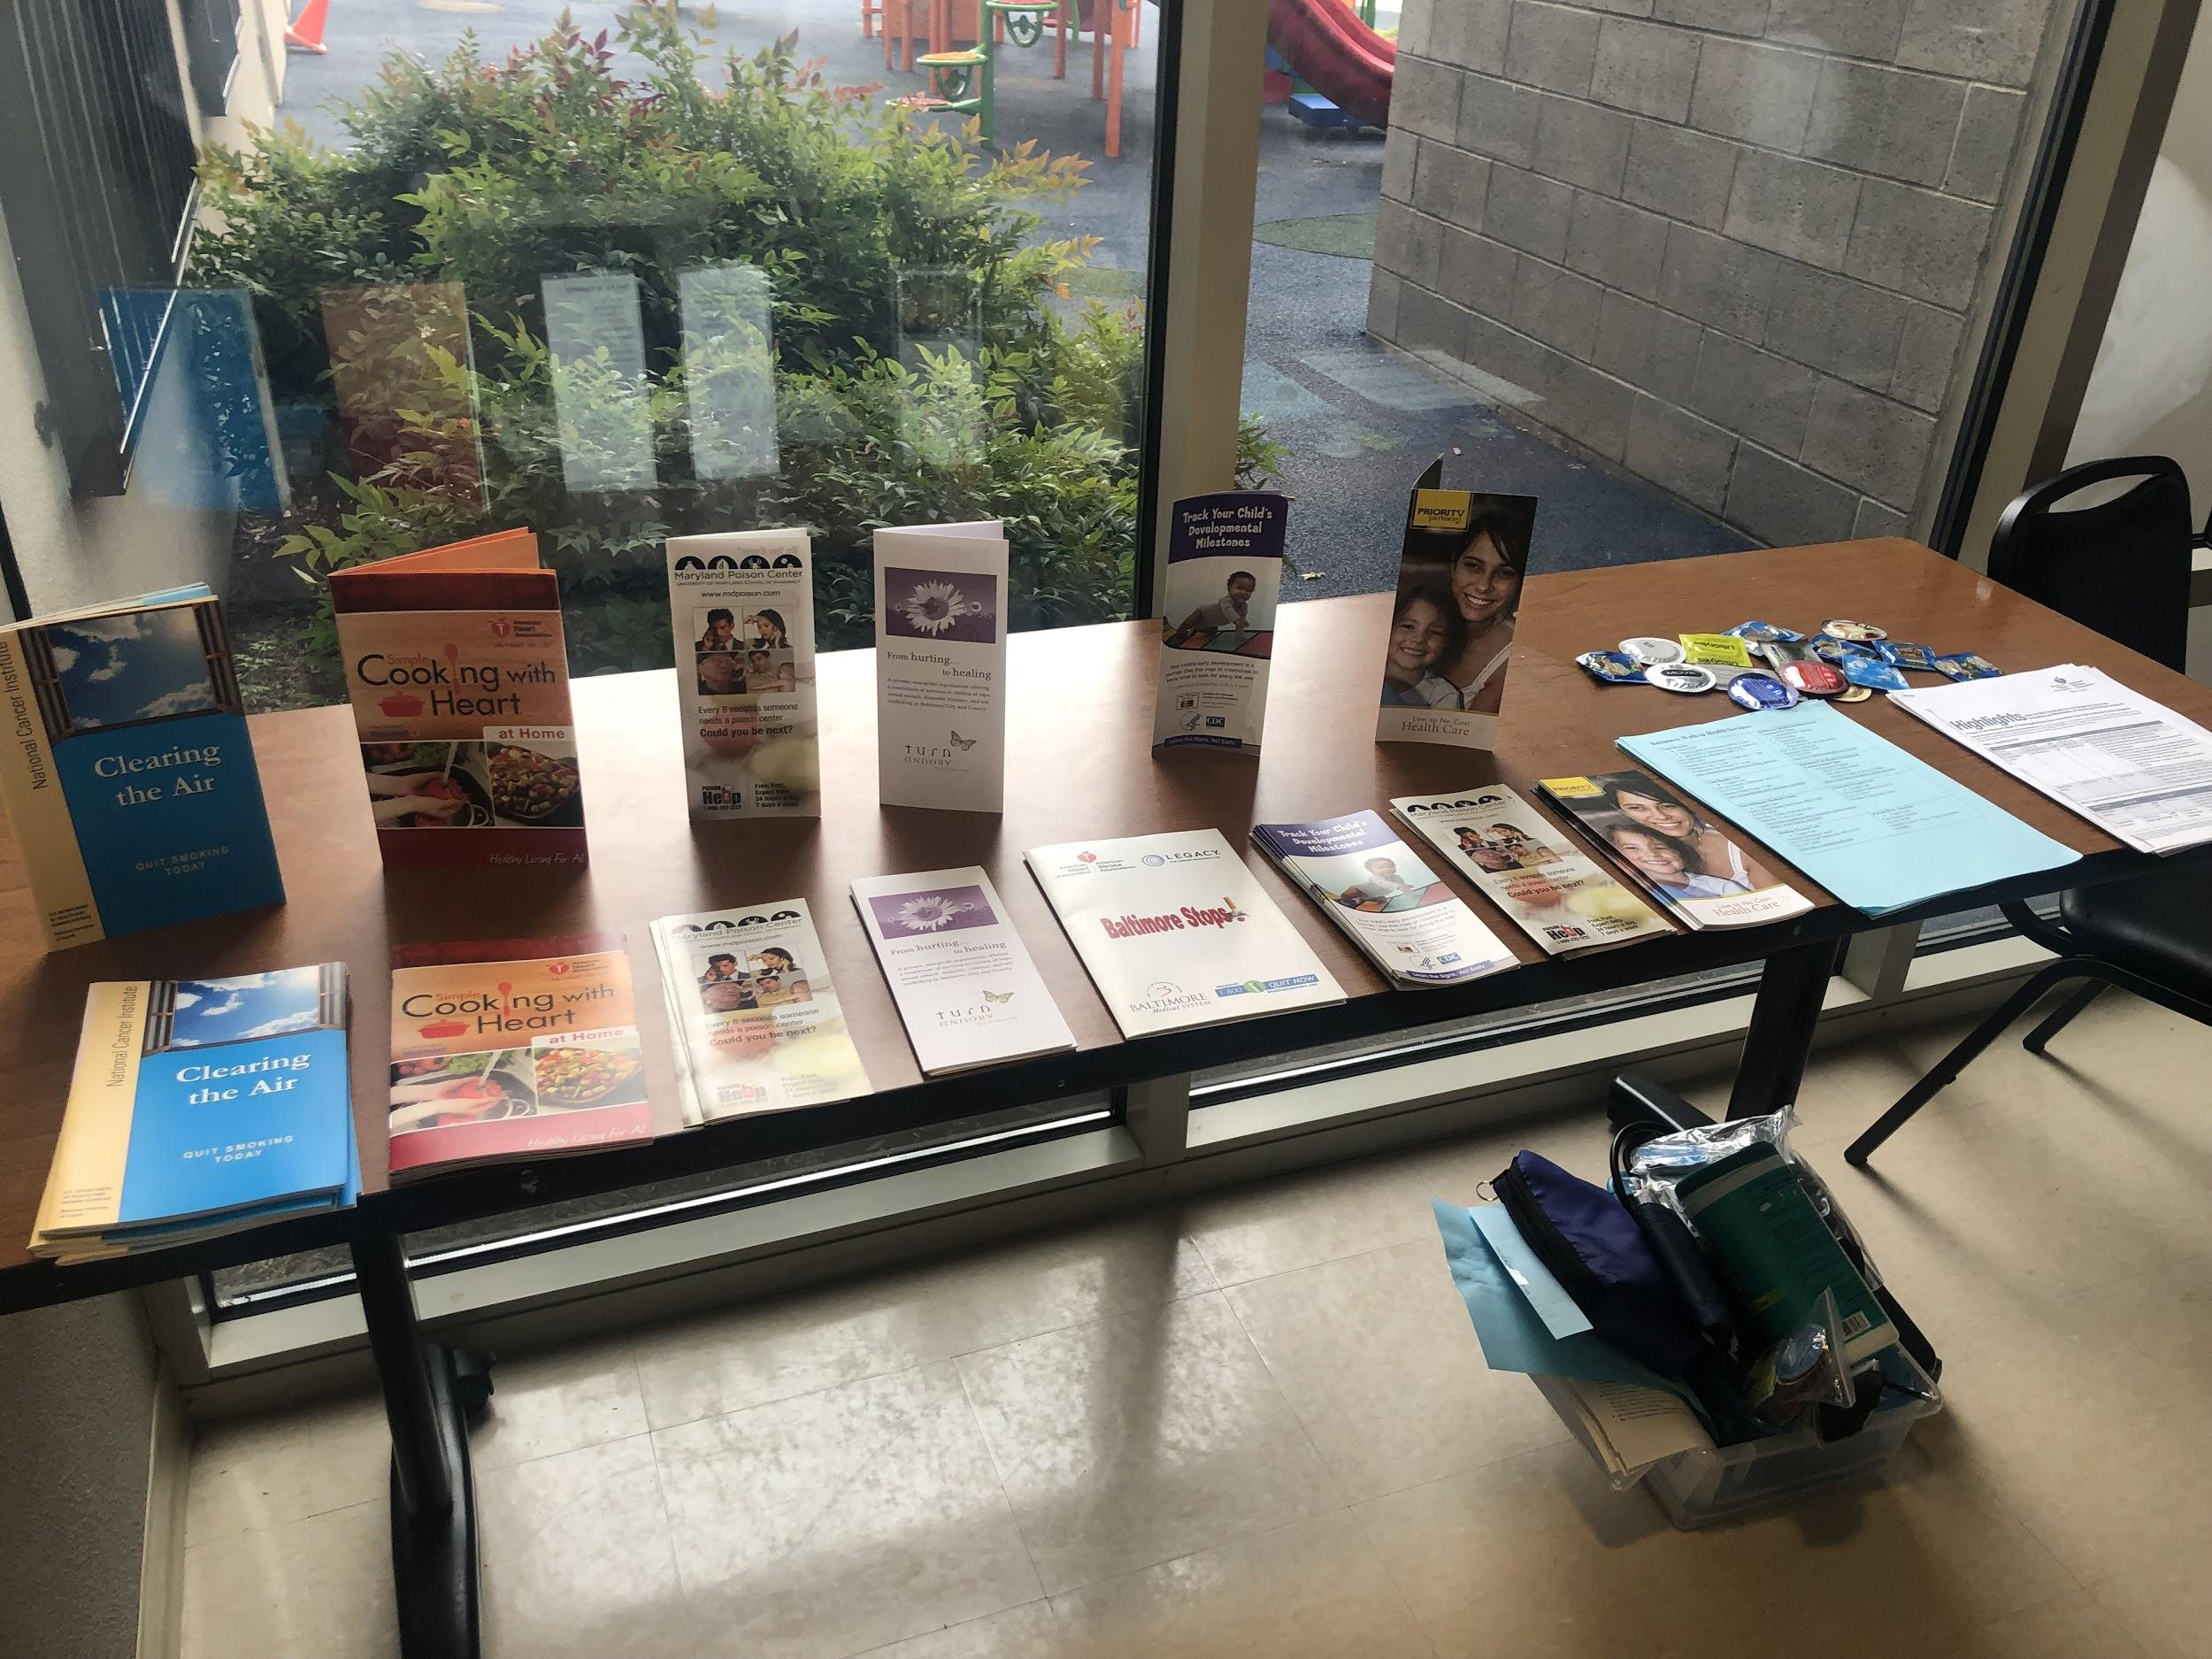
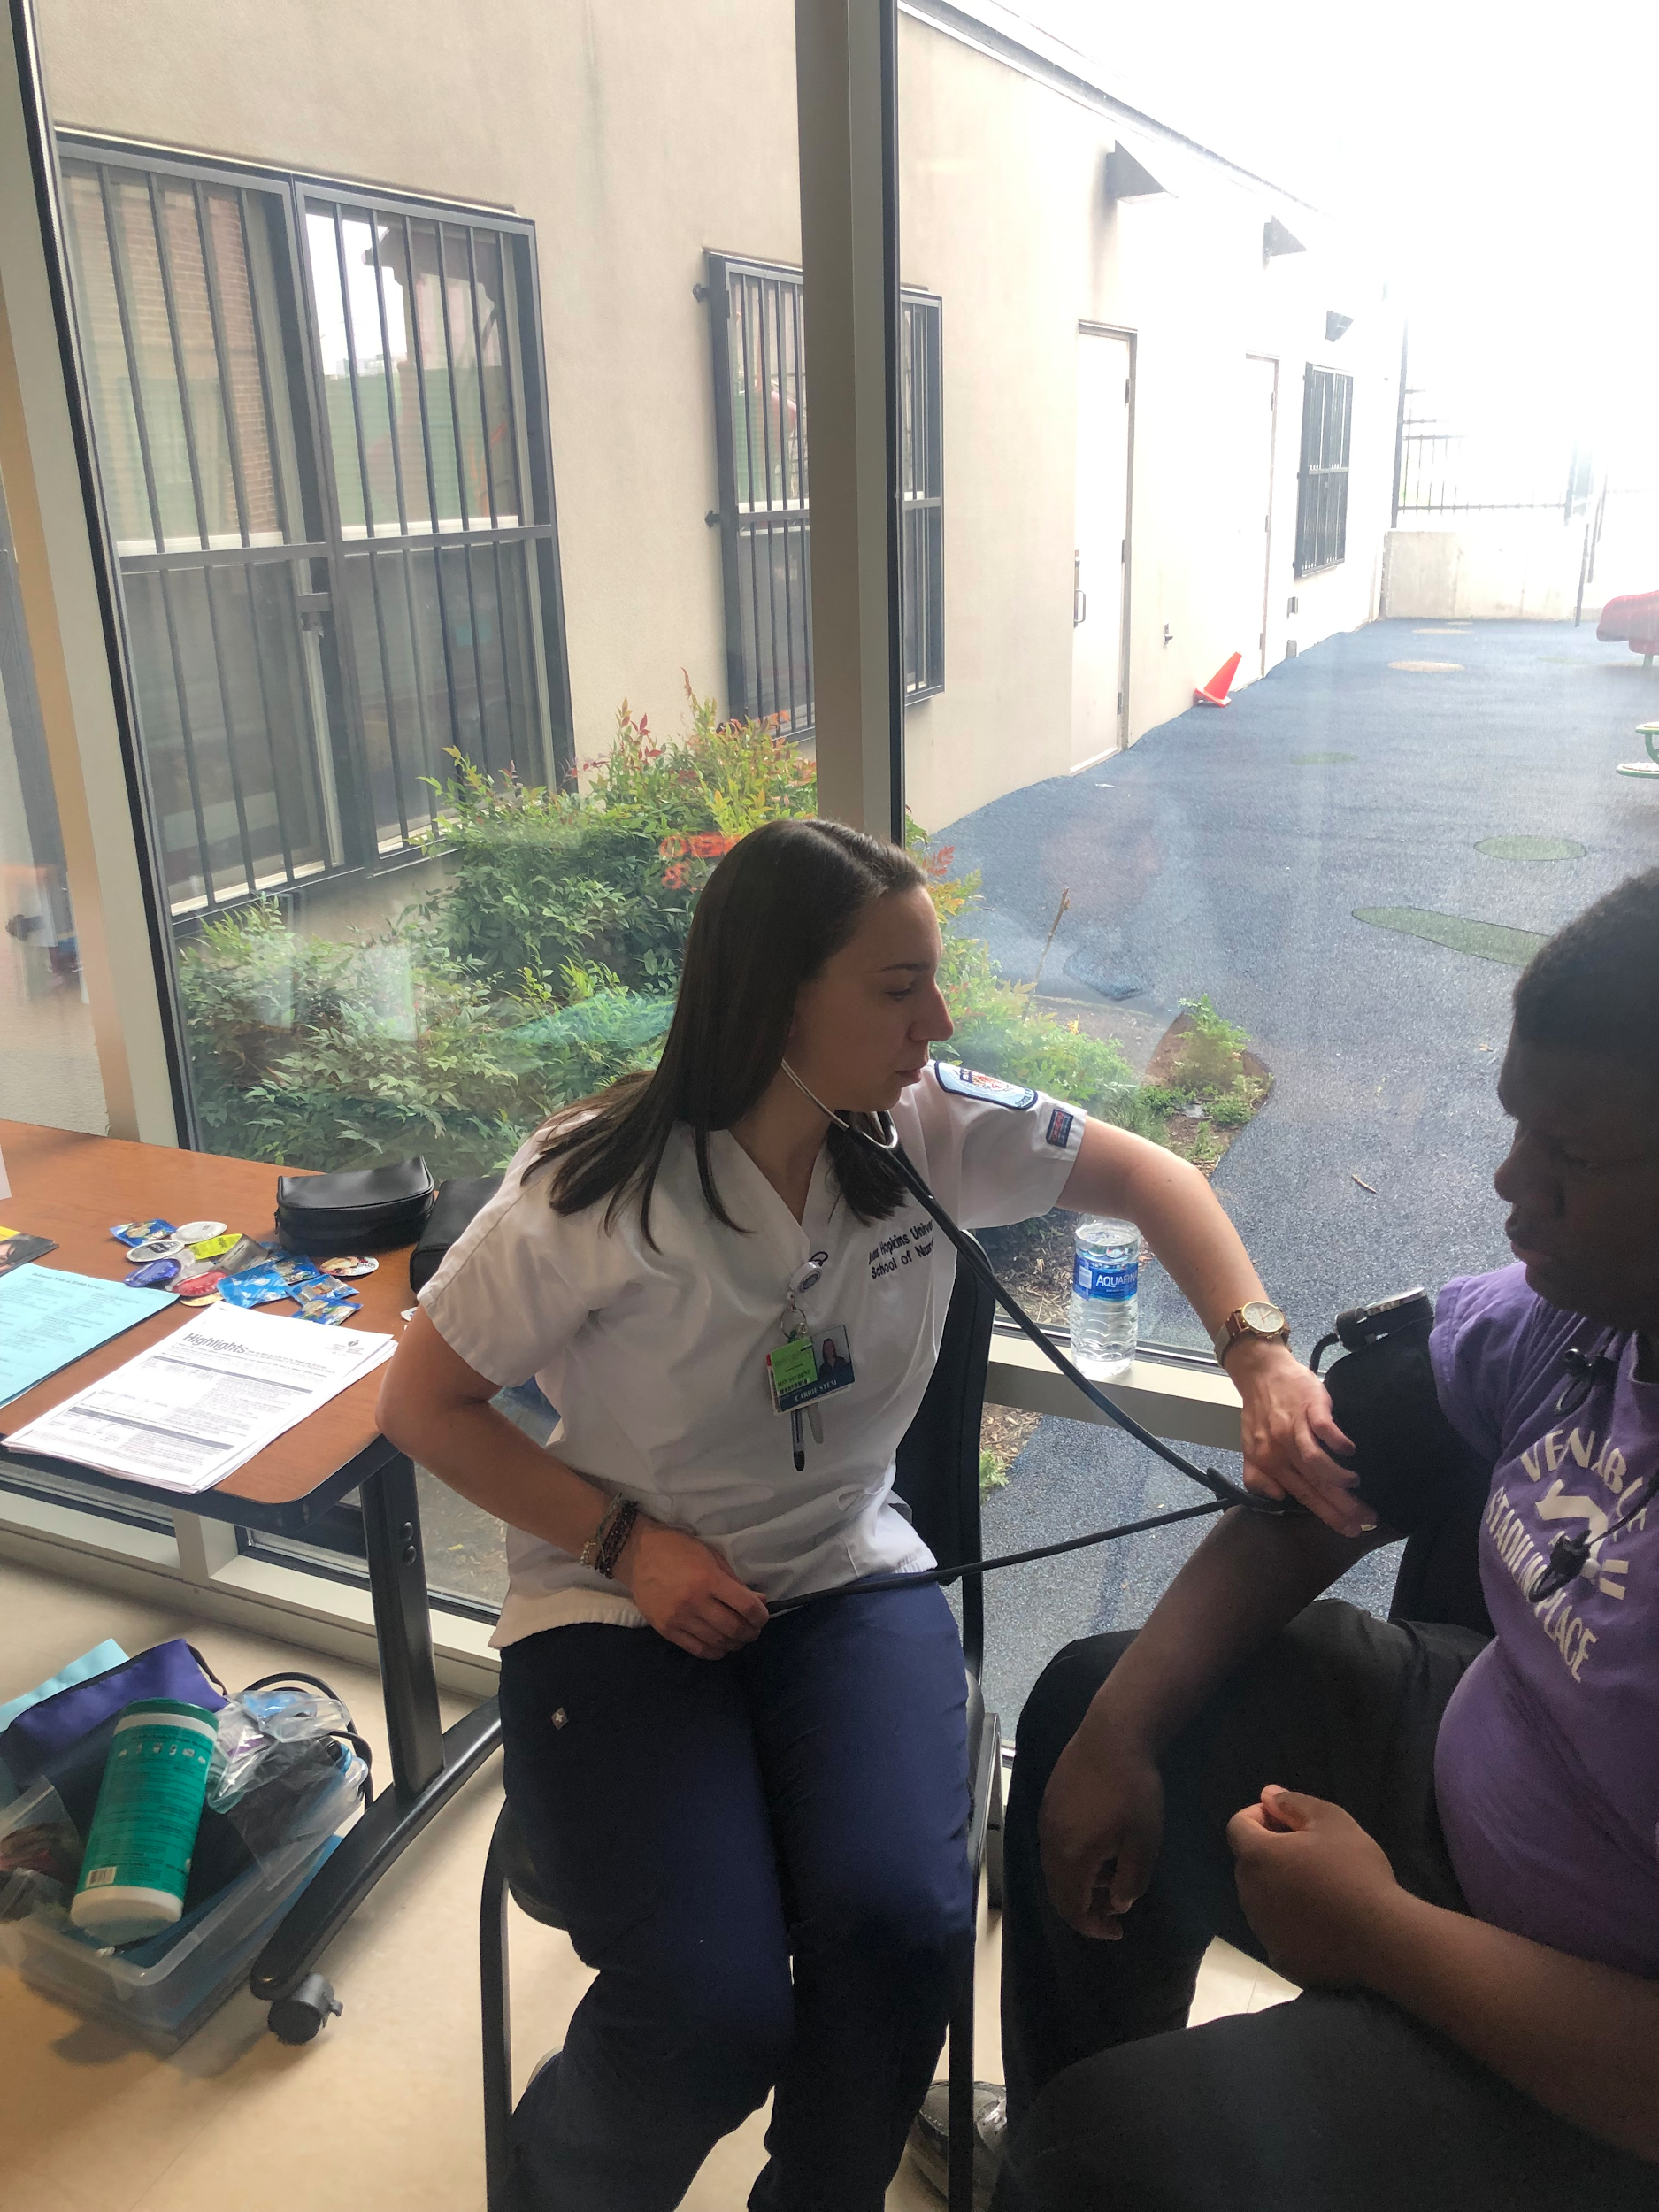
Additionally….
Weekly blood pressure screenings
Weekly meditation
About 25 total home visits serving about 7 clients
Head Start:
  Classroom Teaching
  Men’s Health Screening
  Parenting Counseling (absenteeism, brochures, etc.)

Slide 4
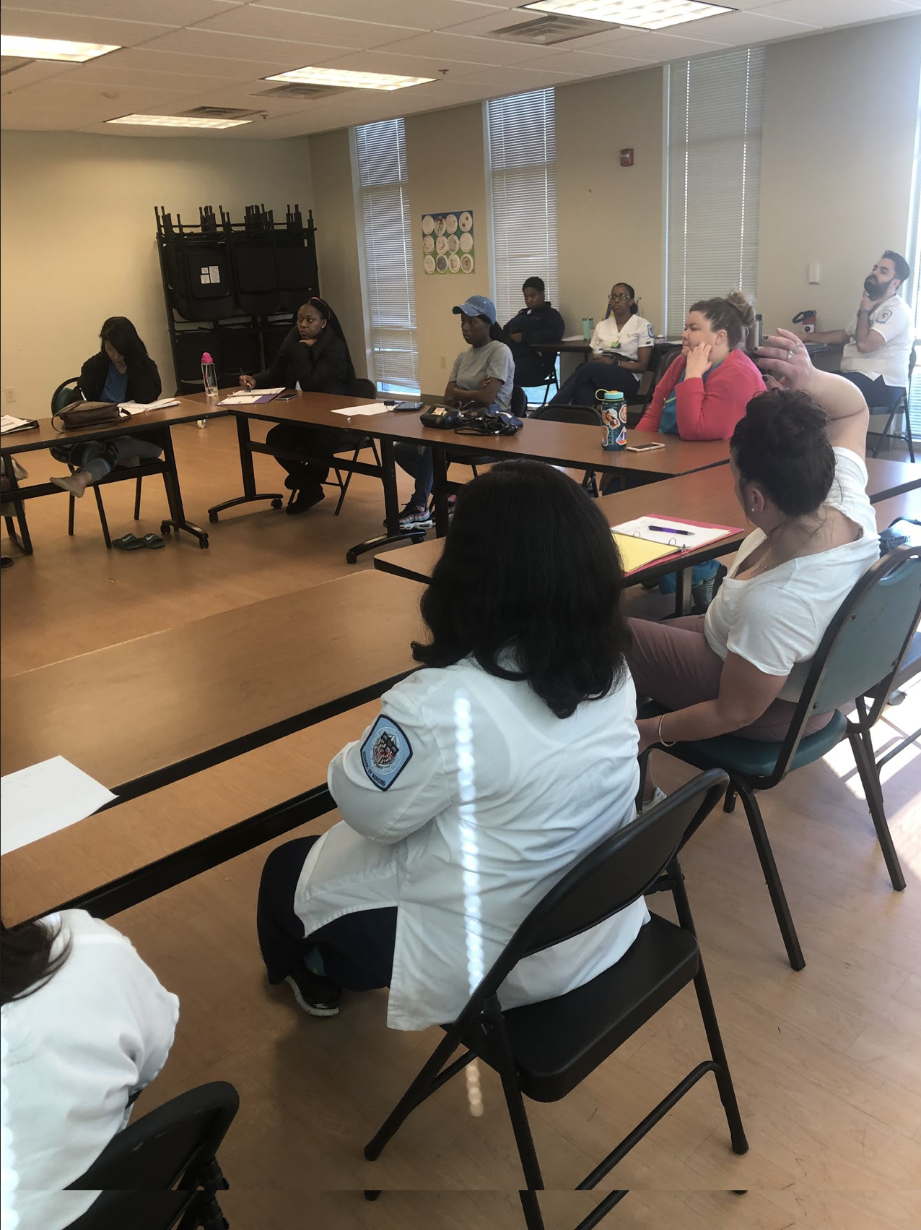
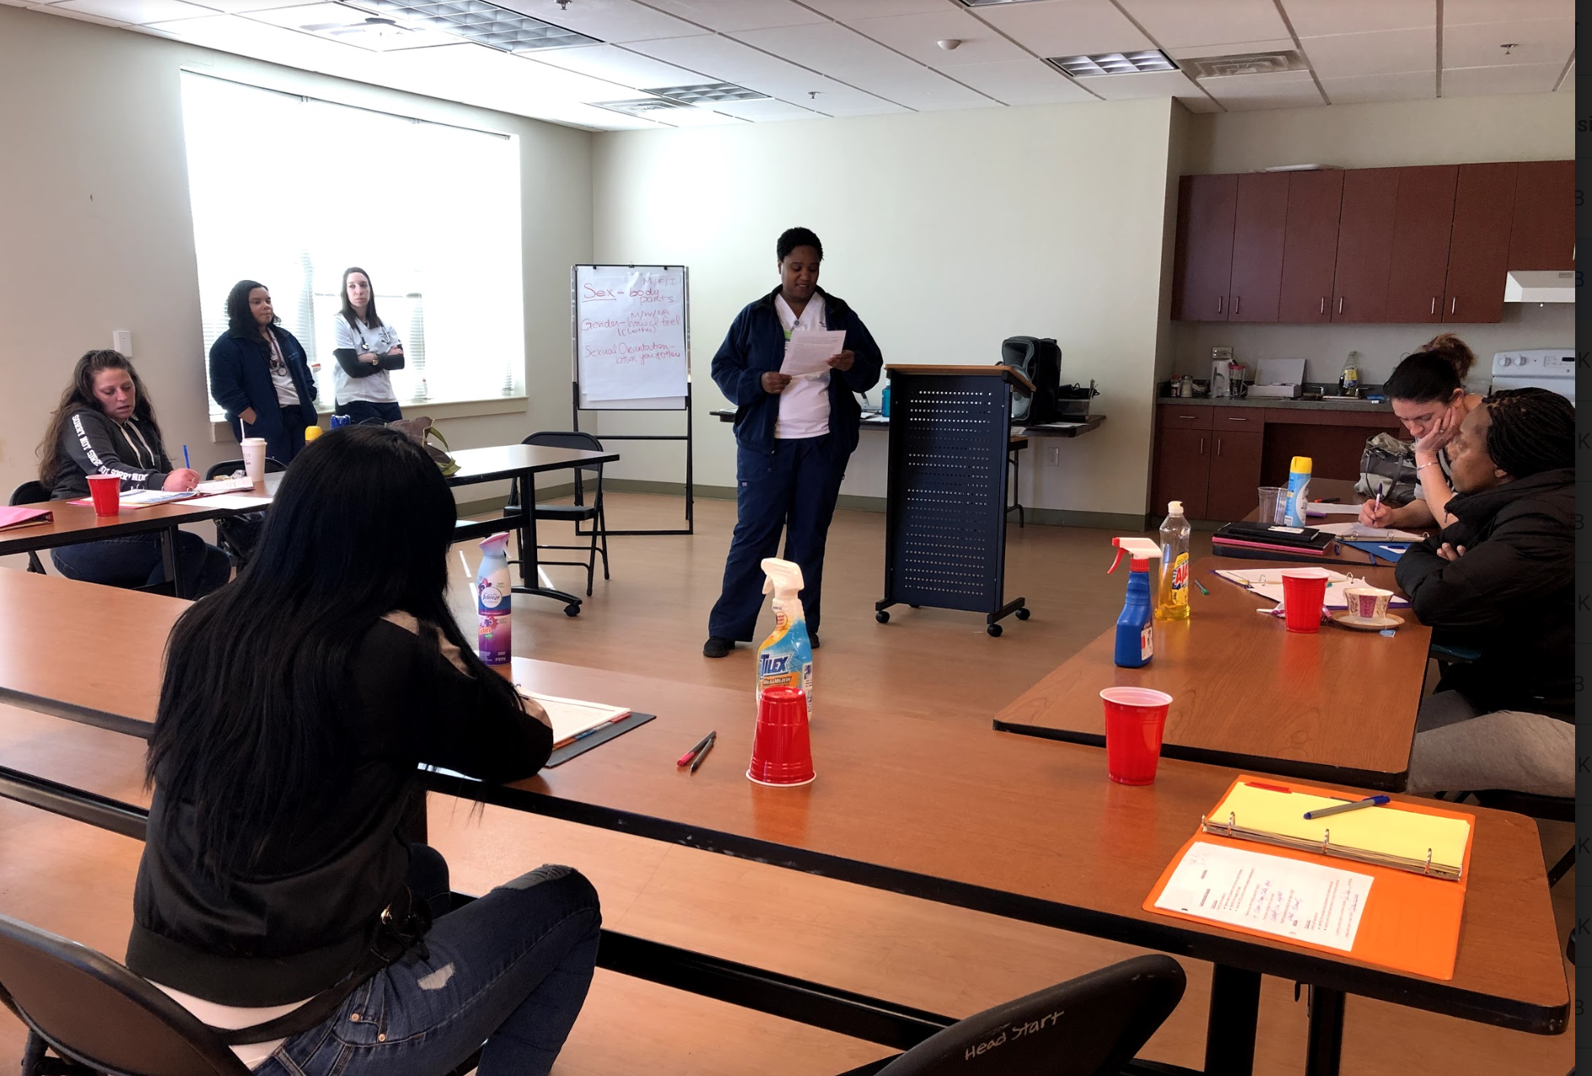
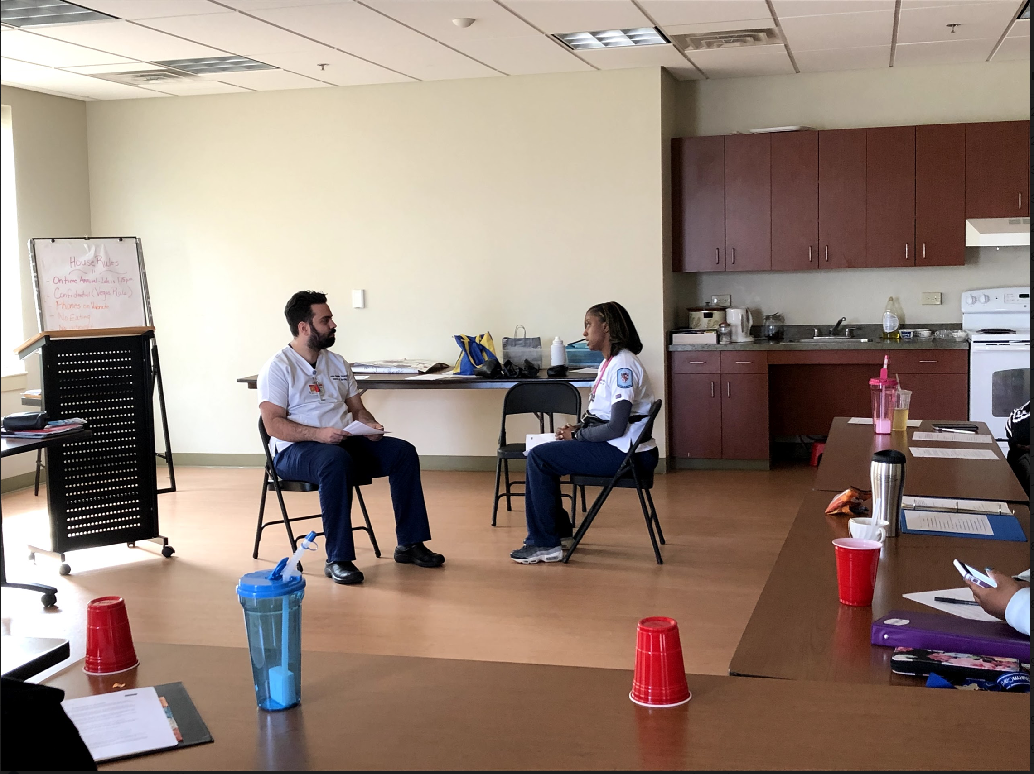
Look at all we have done...

Slide 5


Slide 6
THANK YOU, DAYSPRING!!

